Slide 1


Sewing My OATS
Trials and tribulations of database manipulation

Slide 2

Be sure to know what you’re looking for before you start looking.
Read the questions thoroughly before you start working on your solutions
Notes:
This is a bit of a weakness of mine. I sometimes try to rush through and miss things in the question. It’s really hard to answer something properly when you don’t know the question.

Slide 3
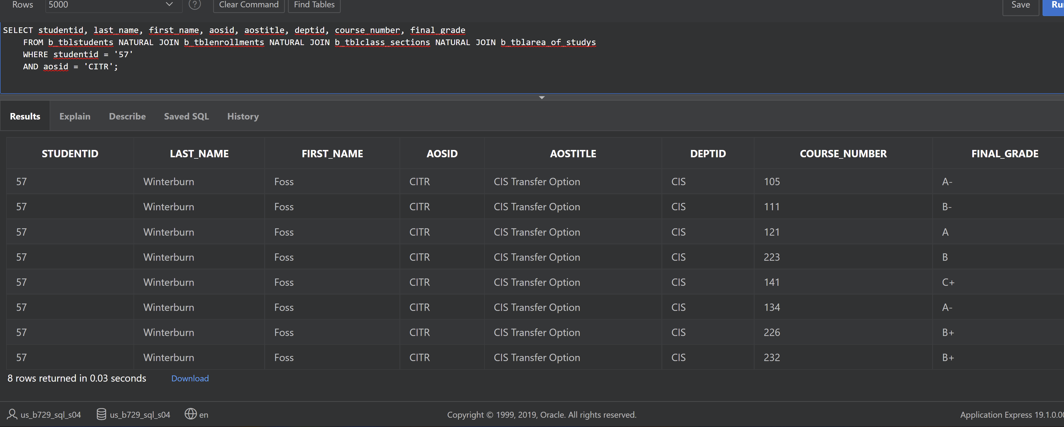
# 9 When done properly returns 8 Rows
The words “for their first area of study” are very important key words
Notes:
Notice there are no rows that repeat

Slide 4
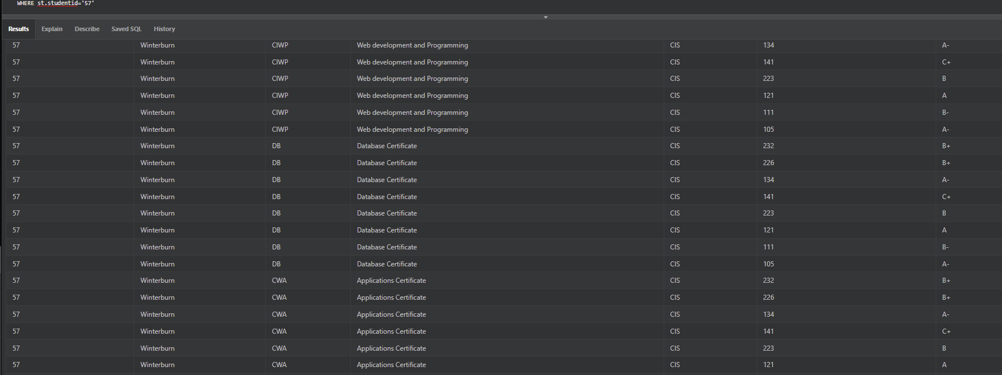
#9 Returns a lot more then 8 rows
When those key words are left out
Notes:
Spent several hours trying to figure out why this would not run without duplicating rows only to then realize I missed a key word in the question.

Slide 5

Double Check Your Work
B_tblAREA_of_Studys
AOSID | CHAR(4)
DEPTID | CHAR(3)
B_tblStudents
STUDENTID | NUMBER(6)
LAST_NAME | VARCHAR2(25)
Over-looking key information such as forgetting to put a table on your ERD can lead to hours of headache till you figure it out.
B_tblEnrollments
ENROLLMENTID | NUMBER(6)
STUDENTID | NUMBER(6)

Slide 6
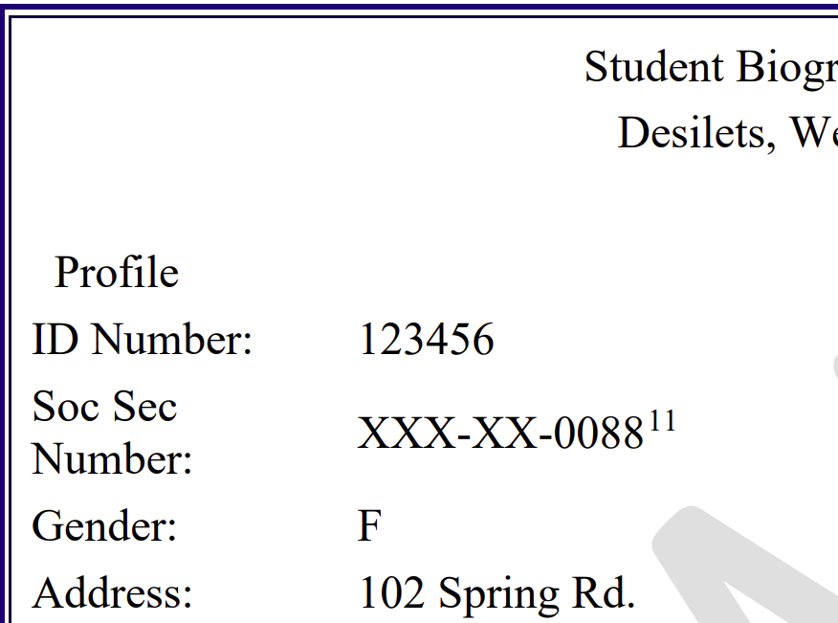
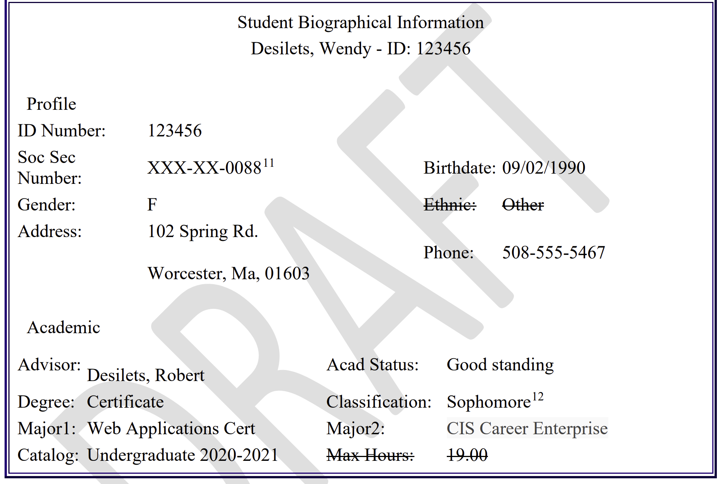
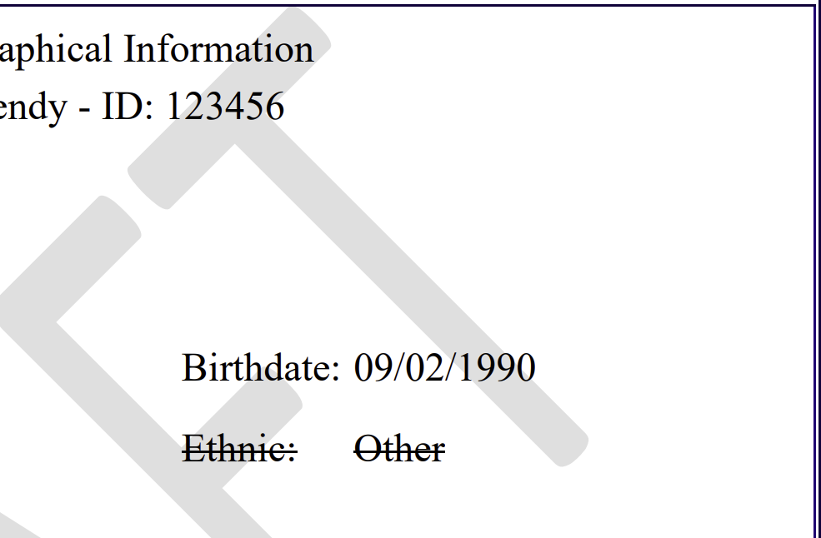
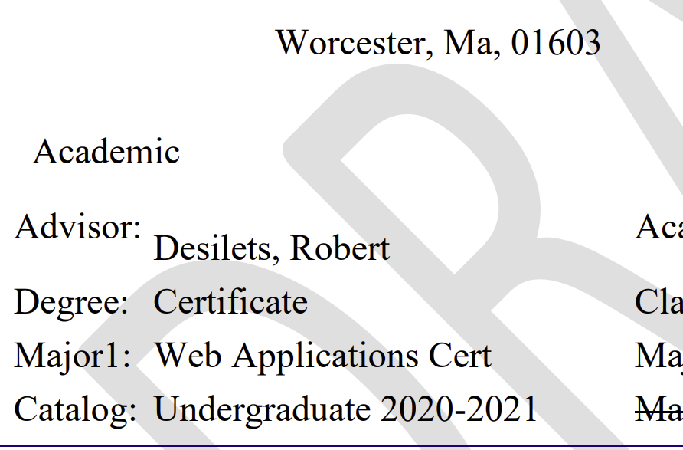
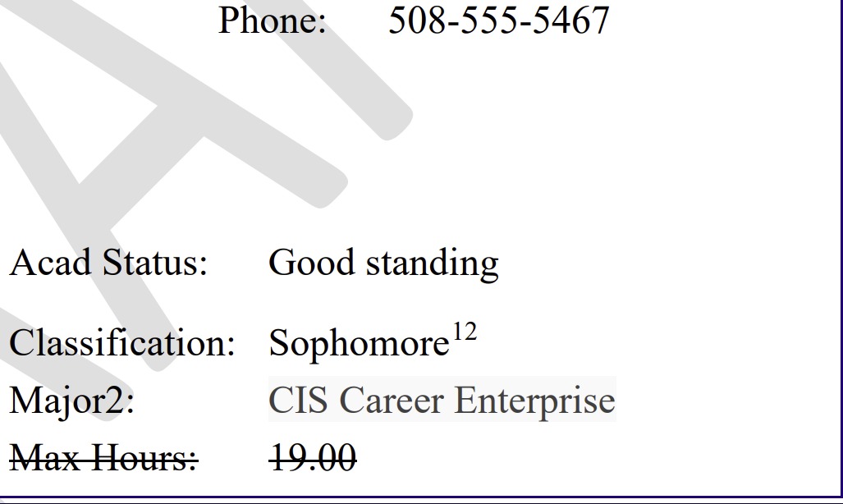
Problems seem to big to handle?
BREAK IT INTO SMALLER SECTIONS AND WORK OUTWARDS
Notes:
This was not a difficult one to figure out, but did take some time and finagling. Breaking into smaller pieces and sections made the problem not only easier to solve but also way less intimidating to tackle.

Slide 7
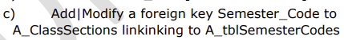
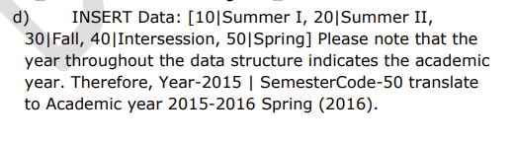
Sometimes “out of order” doesn’t mean broken.
#2 parts c) and d) would only work properly if switched around. The data needs to be inserted before the foreign key can be assigned.
Notes:
Another one that took me some time to figure out. First I kept trying to insert the foreign key into the wrong table, and then once I figured out that mistake I was presented with another. An error message. After some research I realized I needed to switch the order of d and c for them to work.

Slide 8




WHEN IN DOUBT…
ASK BOB!

Slide 9

Bob can point you in the right direction

